Slide 1
THE MATRIX and its Application
not the movie.
Anya Nosa, CS 131

Slide 2
Table of Contents
What is a matrix?
Matrix arithmetic
More on matrices
Zero - one matrices
Application of matrices

Slide 3
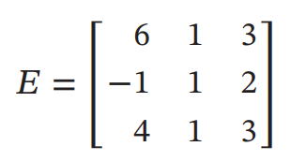
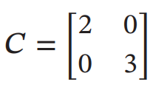
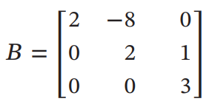
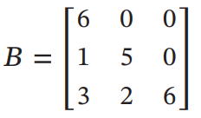
WHat is a matrix
An array of numbers.
The size of a matrix is m x n, where m = # of rows and n = # of columns
A square matrix is n x n, where # of rows = # of columns
Upper triangle, lower triangle, diagonal

Slide 4
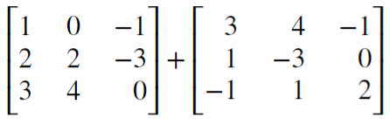
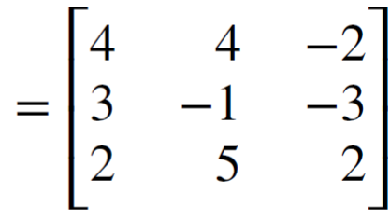
Matrix arithmetic
Addition
The sum of two matrices of the same size done by combining the elements in their respective positions

Slide 5
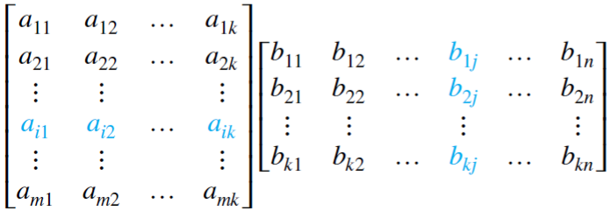
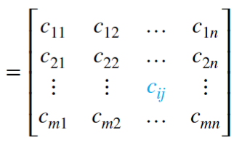
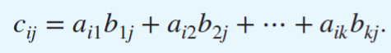
Product
The product of two matrices of size m x k and k x n is done by multiplying the elements in the row of the first matrix by the elements in the column of the second matrix and adding the values together

Slide 6
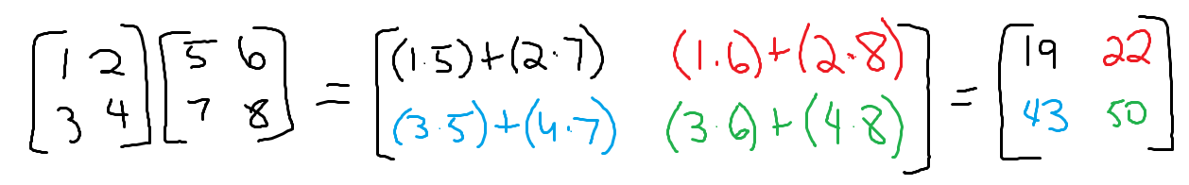

Slide 7
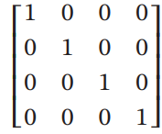
Identity Matrix
4 x 4 matrix
an n x n matrix that is made up of 1’s running diagonally, while the rest of the elements are 0’s

Slide 8
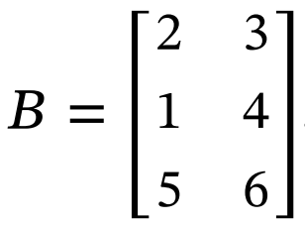
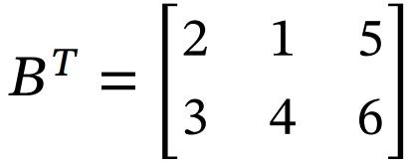
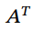
Transpose of a matrix
take m x n matrix and swap the rows with the columns to form an n x m matrix
first row of a matrix becomes the first column of the matrix
: notation

Slide 9
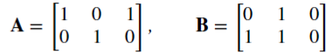
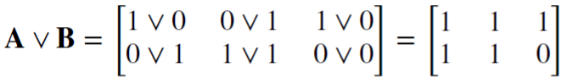
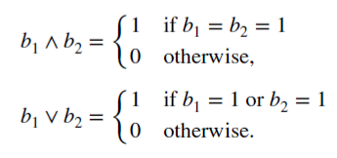
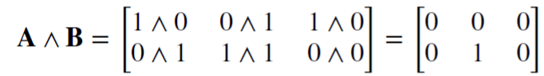
Zero - one matrices
are based on Boolean arithmetic, which are applied to algorithms
Two types:
Join matrix uses notation V (like “or”)
Meet matrix uses notation ^ (like “and”)

Slide 10

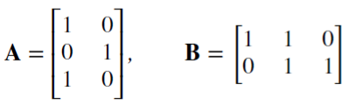
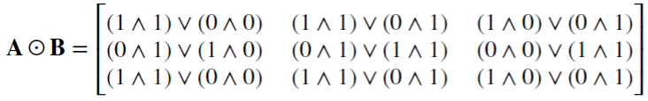
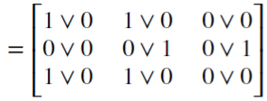
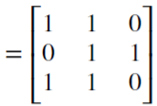
Boolean product
Apply the same process for finding the product of a matrix but now replace multiplication operation with boolean operators

Slide 11
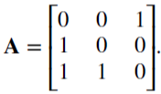
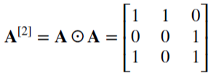
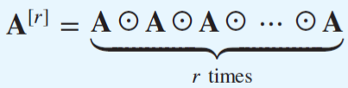
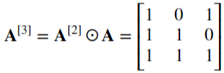
rth Boolean power of A
Given

Slide 12
Application of matrices
physics
geology
Computer science
encryption

Slide 13
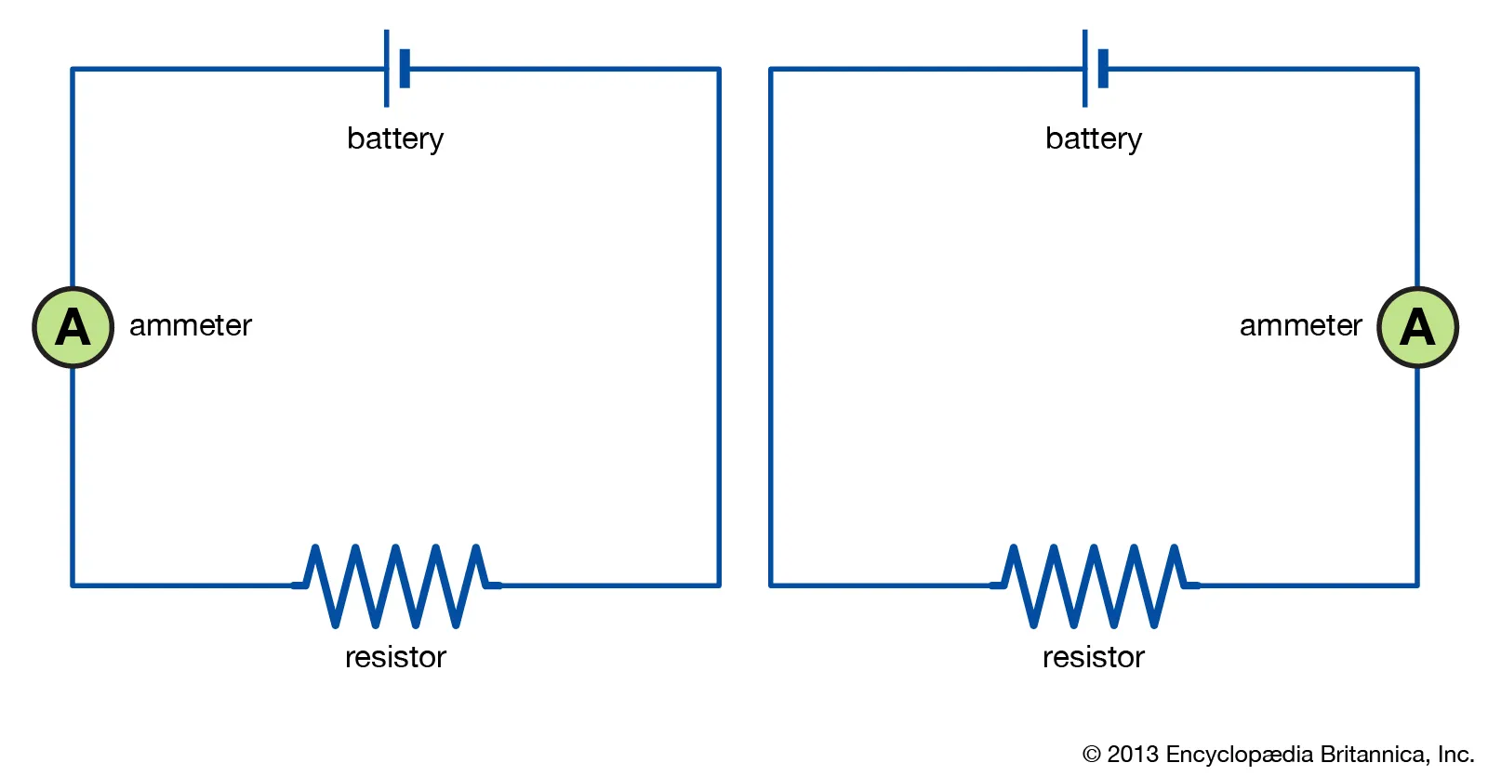
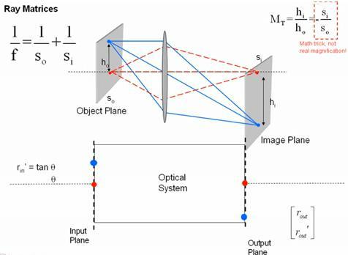
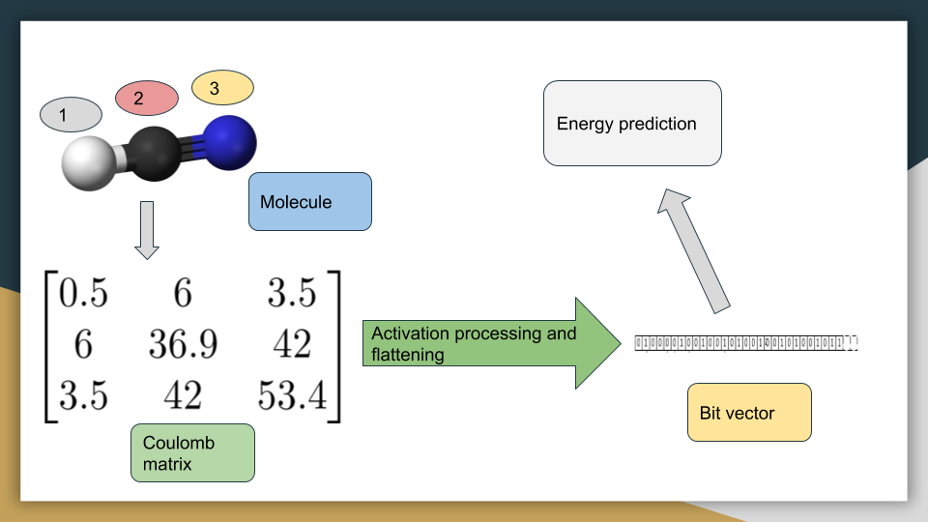
physics
Circuits
Optics
Quantum mechanics

Slide 14
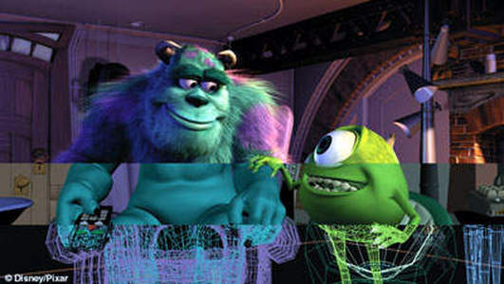
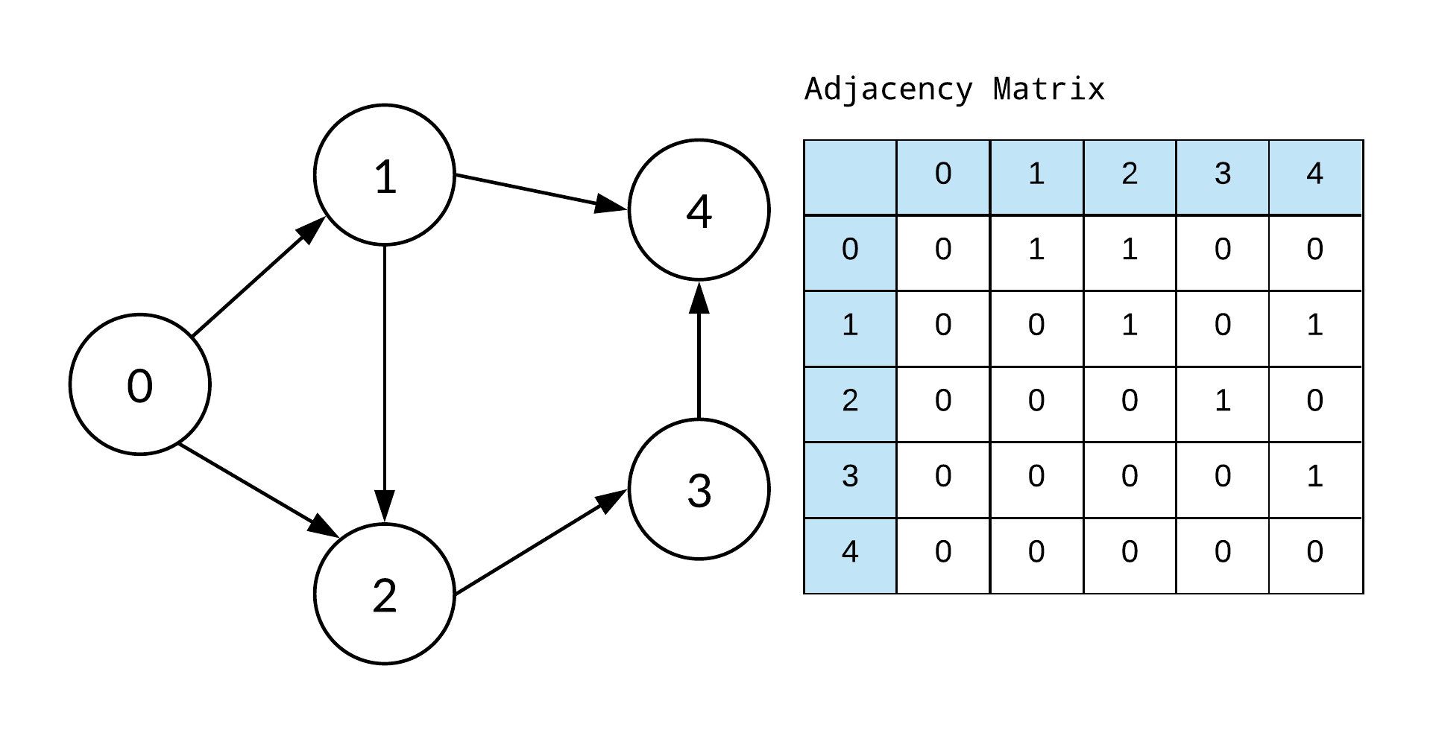
Computer science
3D Image renderings
Solve complicated algorithms

Slide 15
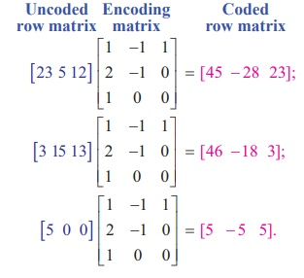

encryption
Cryptography
Internet and bank security

Slide 16
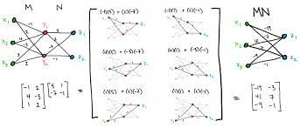
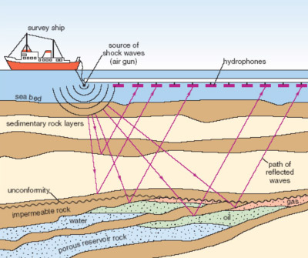
geology
Seismic surveys
Collecting and storing data

Slide 17
Thank you!

